Slide 1
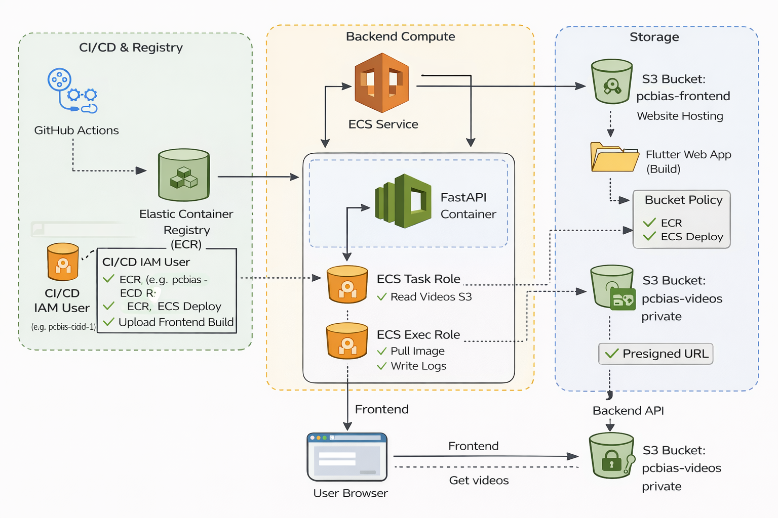
Cloud Deployment Architecture, now with IaC

Slide 2
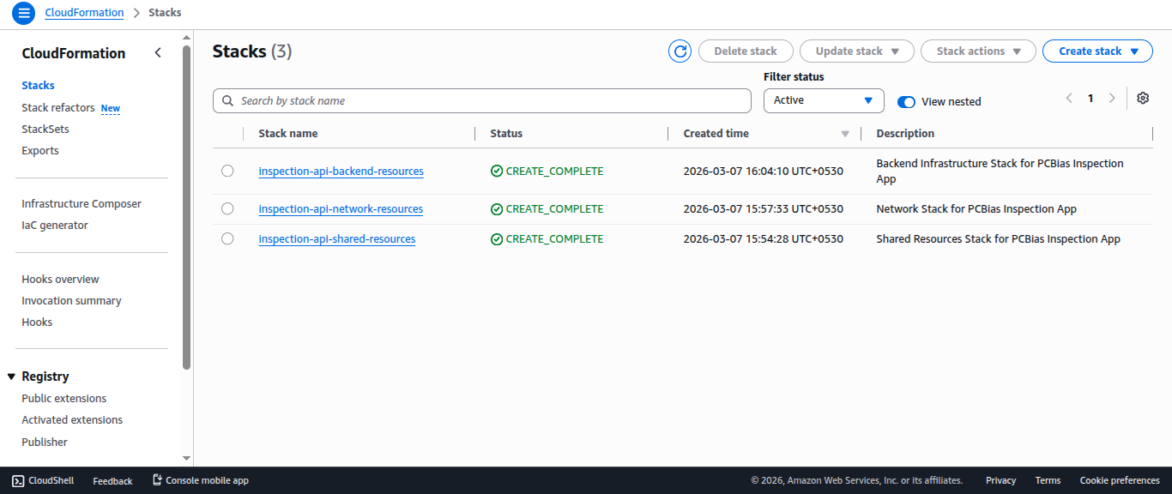
Cloud formation stacks

Slide 3
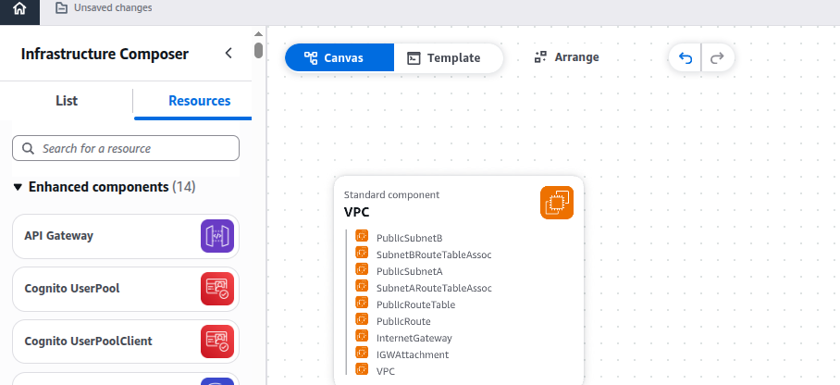
The Network Stack

Slide 4
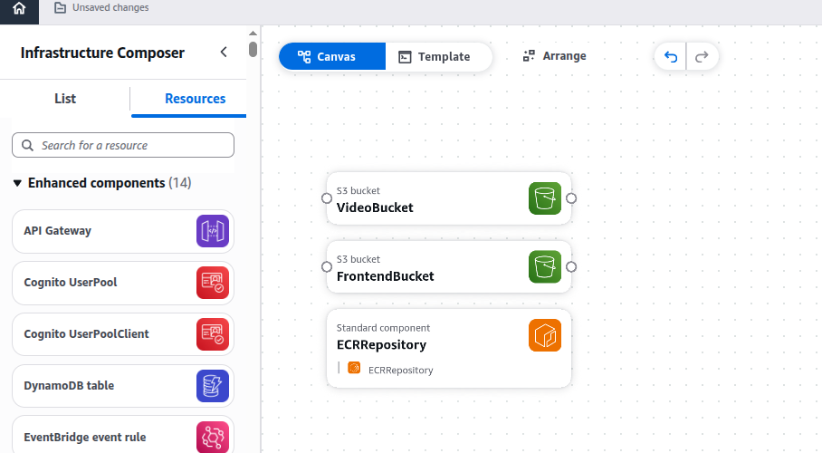
The Shared Resources Stack

Slide 5
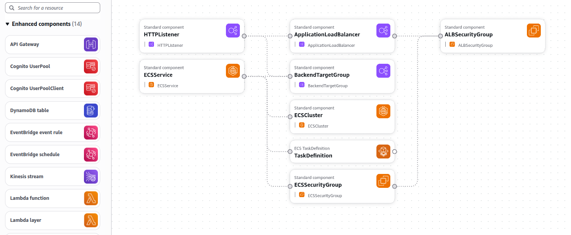
The Backend Stack

Slide 6
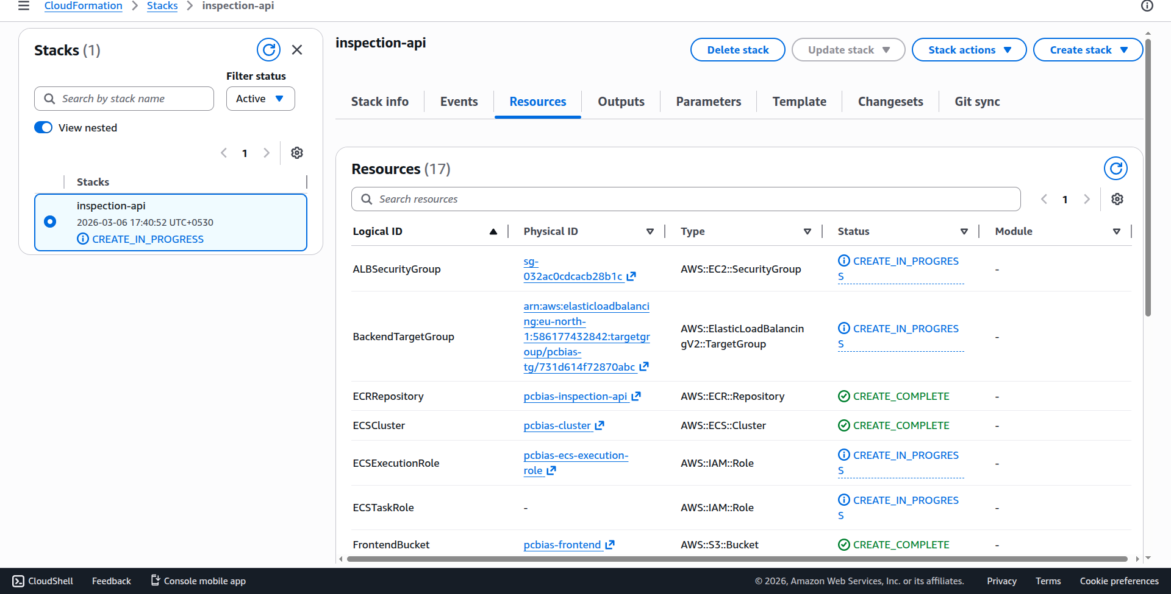
Real time monitoring of infrastructure provisioning

Slide 7
The Result?
Automated Deployment!

Slide 8
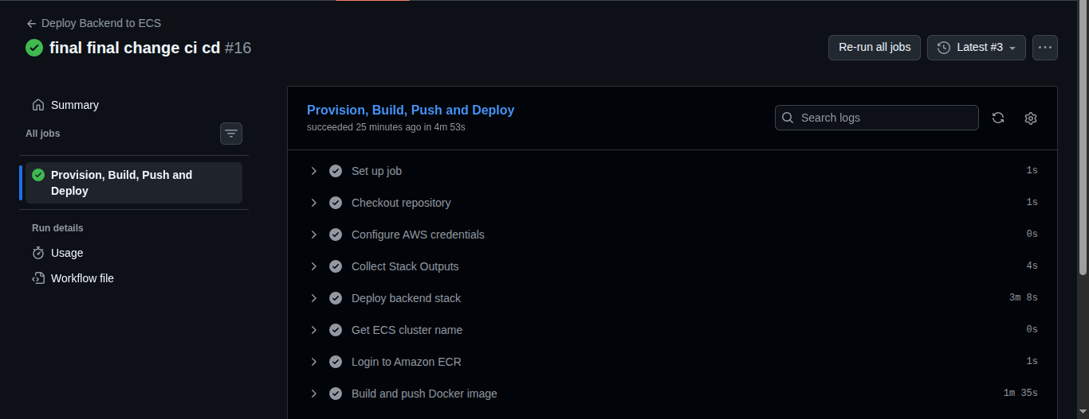
It worked!

Slide 9
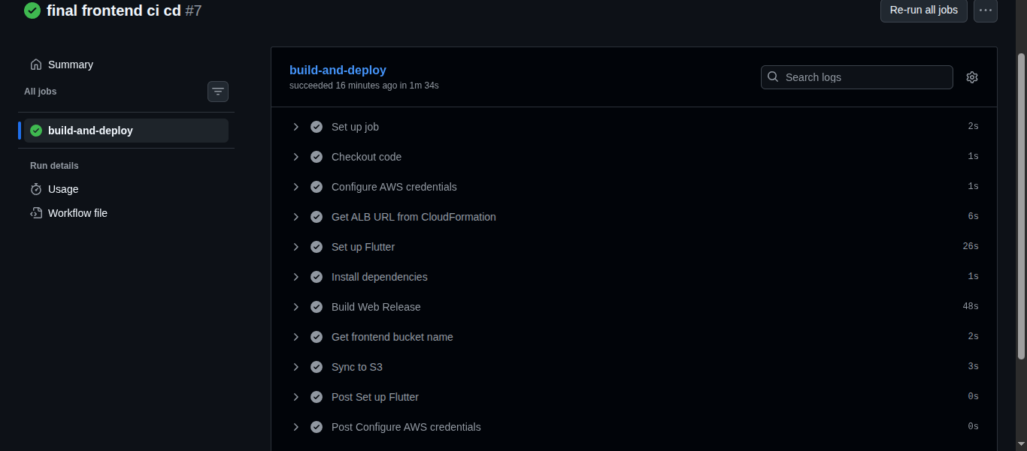
It worked!

Slide 10
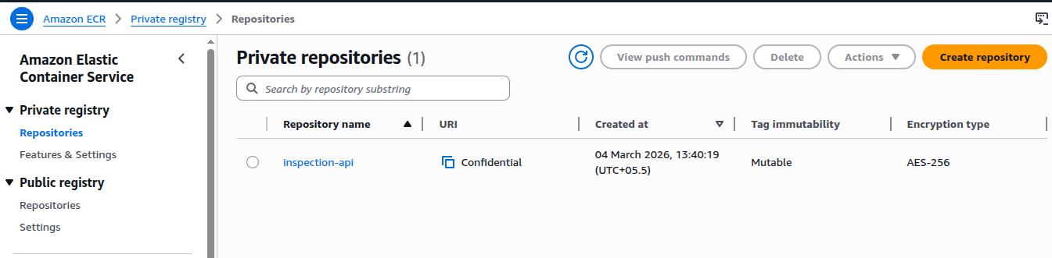
Elastic Container Registry

Slide 11
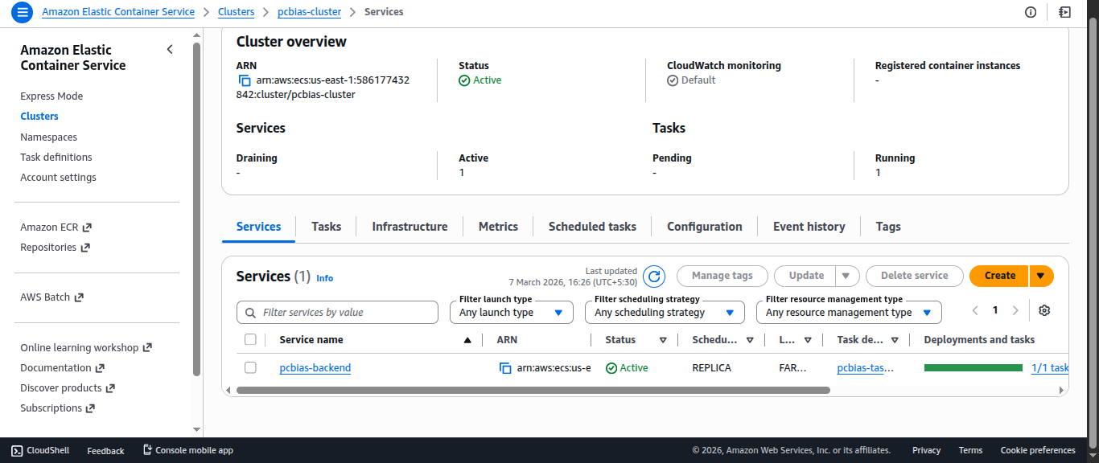
Elastic Container Service

Slide 12
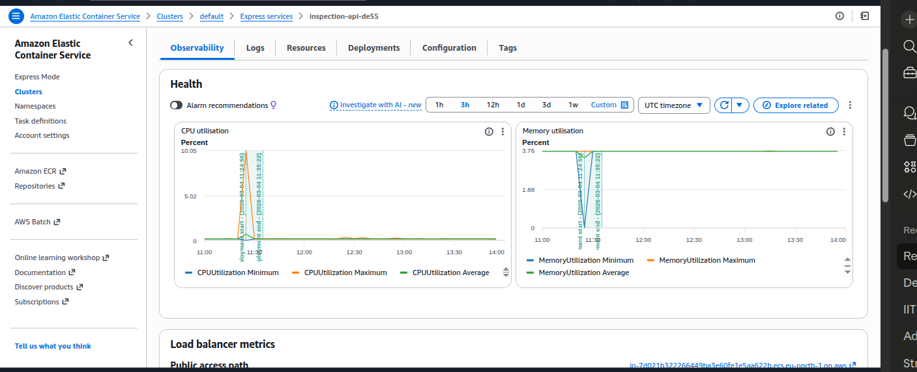
Elastic Container Service

Slide 13
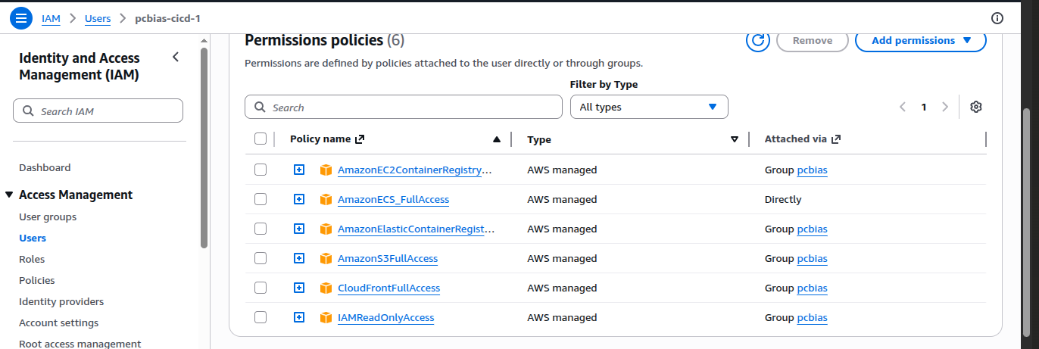
IAM Permissions Used by Github Actions

Slide 14
Thank You

